Slide 1


Next Word Prediction Using LSTM
Presented By- (Group-01)
Sabrina Shawon (1801002)
Abdus Sabur (1801034)
D. M. Khalid Mahmud(1901004)
Marshia Muntaka(1901021)

Slide 2
Next Word Prediction Using LSTM
Introduction
Project
Implementation
Architecture Model
Table of Contents
Result and Discussion
Methodology
Conclusion

Slide 3
Introduction
Prominent application of natural language processing (NLP) and artificial intelligence (AI)
Focuses on predicting the most likely word to follow a given sequence of words in a text or speech
Plays a crucial role in various NLP tasks, including
text completion
spelling correction
intelligent virtual assistants, such as Siri, Google Assistant, and chatbots
Designed to enhance the efficiency of human-computer interactions

Slide 4
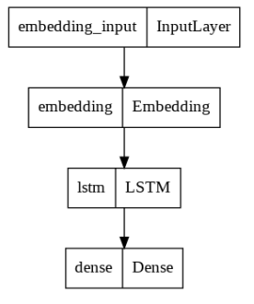
Architecture Model

Slide 5
Methodology
Take the text input
After spliting, train the model
Encorporate layers: Embedding layer, LSTM, Dense
Preidict the next word/words

Slide 6
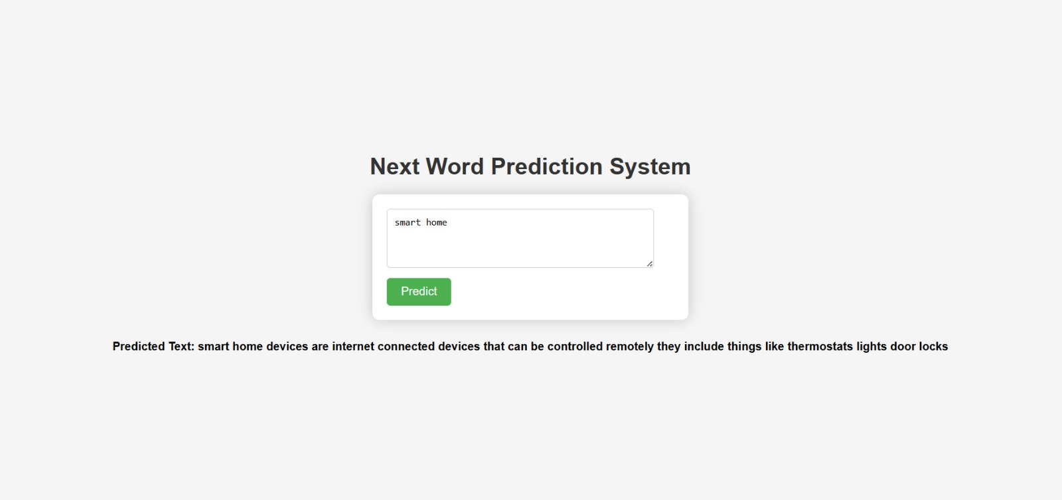
Project Implementation

Slide 7
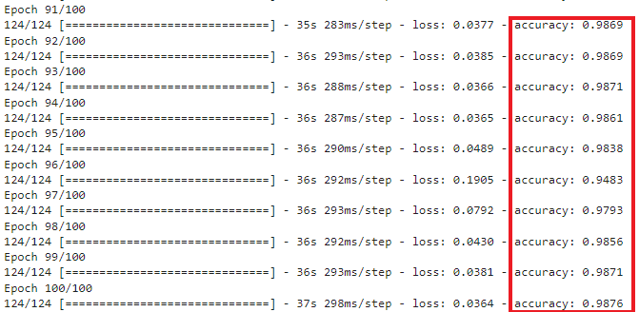
Result and Discussion

Slide 8
Advantage and Limitations
Advantages | Limitations
LSTM networks are able to learn long-term dependencies in sequential data, which makes them well-suited for next word prediction | LSTM networks can be computationally expensive to train and deploy
LSTM networks are able to capture complex patterns in sequential data, which allows them to make accurate predictions even in challenging cases | LSTM networks can be sensitive to the quality of the training data. If the training data is noisy or incomplete, the LSTM network may not be able to learn accurate predictions
LSTM networks are able to generalize well to new data, which means that they can be used for next word prediction on a variety of different tasks | LSTM networks can be susceptible to bias, which can lead to inaccurate predictions for certain groups of users

Slide 9
Conclusion
A vital aspect of natural language processing
Offering improved user experiences and efficiency in various applications
Driven by advanced machine learning models and ongoing research in the field

Slide 10
Thank You...

